Slide 1

Epic Trips Analysis

Slide 2
Key points
United States of America is the top performer amongst all of the categories shown in this presentation. We must continue to maintain and improve our relationship with the USA customers.
We need to create a stronger bond between the Mobile App engagement and the Mobile Web engagement. We need to improve app functionality through A/B testing, customer questionnaires and various others.
Australia, United Kingdom and South Korea are under developed areas which can benefit from improvement due to their large Conversion Rate and the Gross Revenue that they have generated.

Slide 3
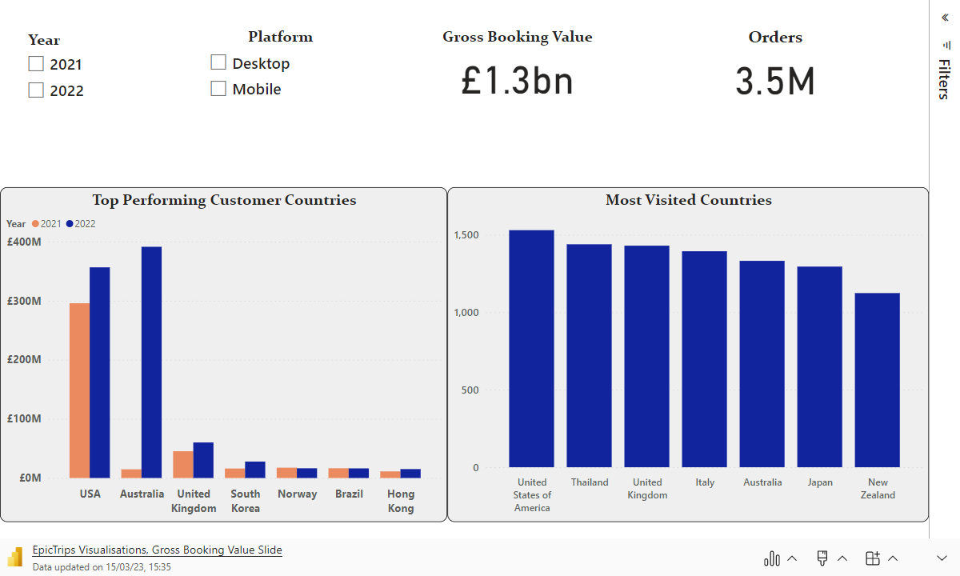

Slide 4
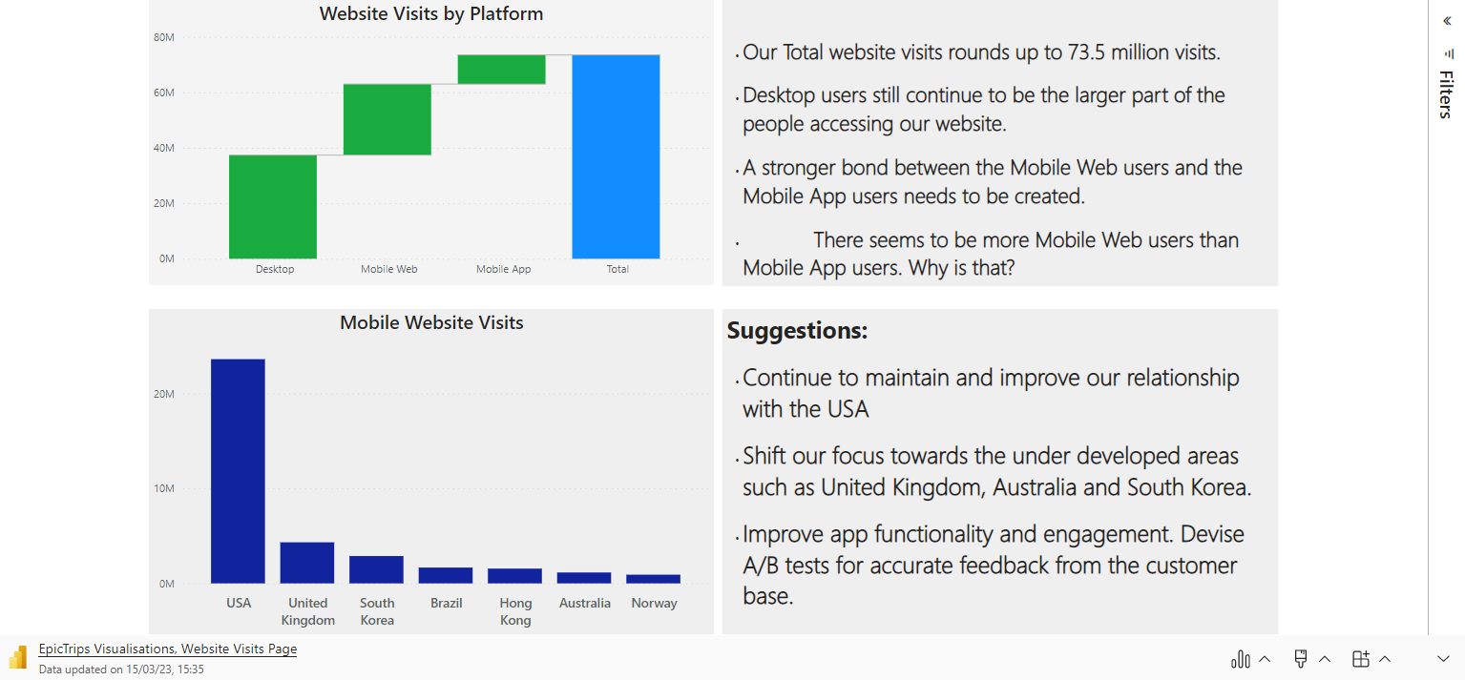
Website Visits

Slide 5
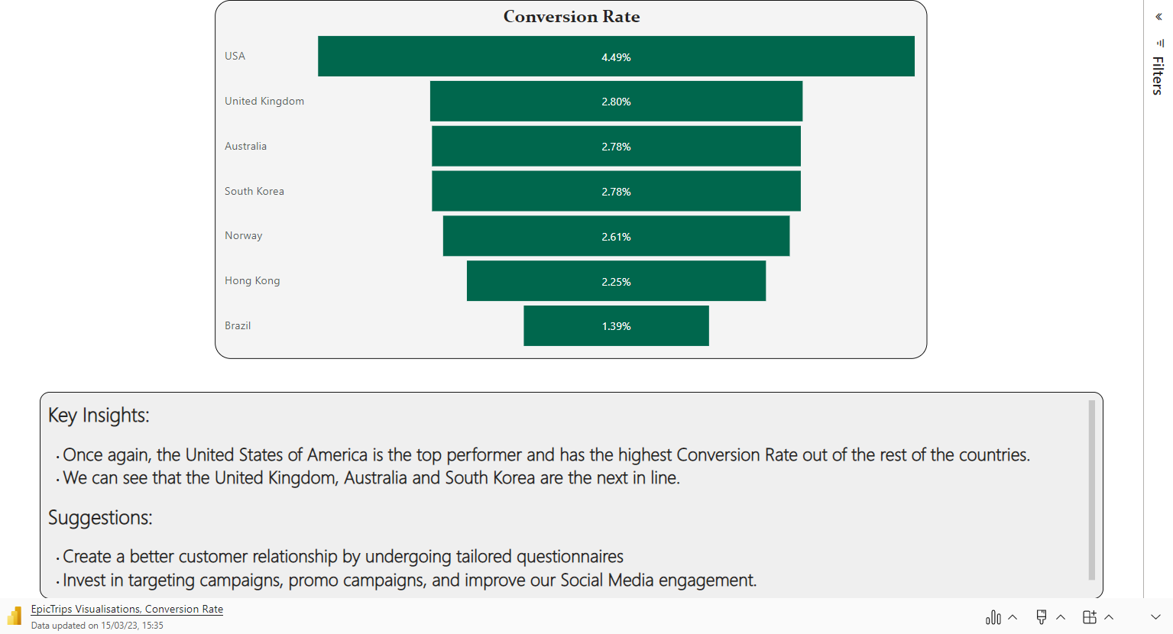

Slide 6
